Slide 1
Email and calendar on the go
Training Deck
Microsoft Corporation
Notes:
-------------------
1. Get it done from anywhere
2. Email and calendar on the go
3. Store, sync, and share your work files
4. Run more effective meetings
5. Work like a network
-------------------

Slide 2
Email and calendar on the go
Outlook and Outlook Web App
With Office 365, you have easy access to your email and calendar wherever you are—on your computer, tablet, or phone. To view your email or calendar on your computer, you can use Outlook or Outlook Web App. To view your email or calendar on your phone or tablet, you can use Outlook Web App or a compatible app that’s on your device (such as an email and calendar app).
Outlook is an application that you install on your computer.
Outlook Web App is the browser-based version of Outlook that you can access over the internet, on just about any device.
For more information, see Compare Outlook and Outlook Web App.
In this training deck, we focus mostly on things you can do in Outlook Web App. However, we also provide links to information about Outlook.

Slide 3
Email and calendar on the go
View your email
View your calendar
Change your theme
Set up an automatic signature for your email
Set up automatic replies for when you’re unavailable
Find or add a contact
Schedule a meeting
Share your calendar with others
View a shared calendar
more

Slide 4
Email and calendar on the go
Search your email or calendar
Assign tasks for yourself or others
Get additional resources and information

Slide 5
View your email
With Office 365, you can view your email on your computer, tablet, or phone.
On your computer, you use Outlook.
On your phone or tablet, you use an app.
On just about any device, you can access your email in a browser window using Outlook Web App.
Compare Outlook and Outlook Web App

Slide 6
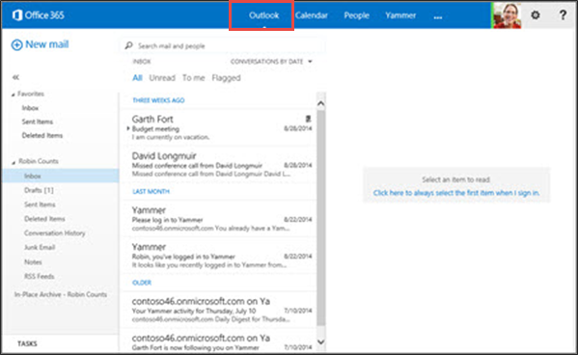
View your email
To view your email quickly in a browser window, use Outlook Web App.
Open your web browser and go to http://portal.office.com.
In the navigation across the top of the screen, choose Outlook.
Select a message to view in the reading pane.
For information about using Outlook on your desktop:
If you’re using Windows, see: Outlook 2013.
If you’re using Mac, see: Set up email and View your email.

Slide 7
View your calendar
Outlook provides a calendar that you can use to schedule your meetings and appointments. Your calendar will remain up to date across all your devices where you’re using Office 365.

Slide 8
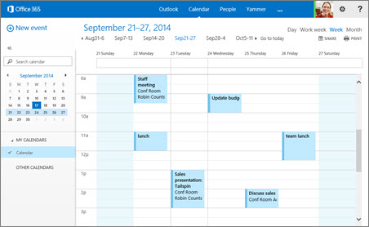
View your calendar
Access your calendar quickly in a browser window using Outlook Web App.
Sign into Office 365, choose Calendar.
To change your calendar view, such as from day view to week view, choose day, work week, week, or month in the upper right corner.
For information about using Outlook on your desktop:
If you’re using Windows, see: Outlook 2013
If you’re using Mac, see: Set up email and See your calendar.

Slide 9
Change your theme
You can easily change the theme you use for Office 365. Choose from a wide variety of colors and patterns to make Office 365 your own.

Slide 10
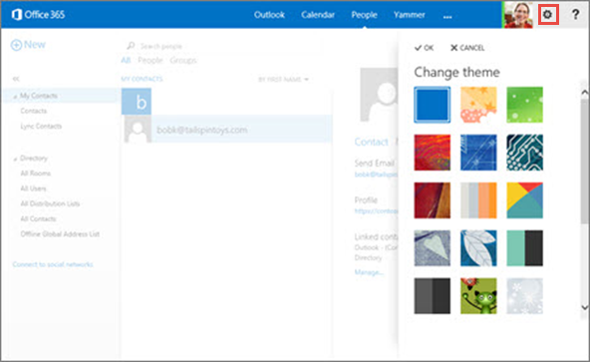
Change your theme in Office 365
One way to personalize Office 365 is by changing the theme. It’s quick and easy to do.
Sign into Office 365, choose Outlook, Calendar, or People.
Choose Settings > Change theme.
Select the theme that you want, and then select OK.
Note: Changing your theme in Office 365 does not change the theme you might be using for Outlook on your desktop.
To change the theme for Outlook 2013 see Change the Office theme.

Slide 11
Set up an automatic signature for your email
One way to put Office 365 to work for you is by adding an automatic signature to your email. This is useful when you don’t want to type your contact information at the end of every message. It also helps maintain consistency across the messages you send.

Slide 12
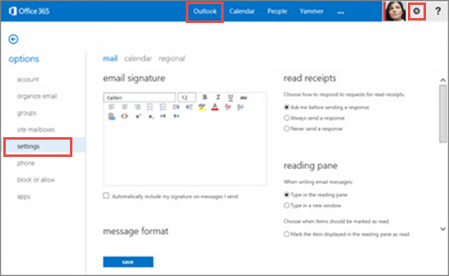
Set up an automatic signature for email
Your personalized signature can automatically be added to outgoing messages, or you can choose to add it to specific messages only.
Sign into Office 365, and choose Outlook.
Choose Settings > Set automatic replies.
Choose settings > mail.
Type the text for your signature, and specify the font and other settings you want to use.
Select Automatically include my signature on messages I send, then Save.
To set up an automatic signature in Outlook on your desktop:
If you’re using Windows, see Create and edit email signatures.
If you’re using Mac, see: Create a signature.

Slide 13
Set up automatic replies for when you’re unavailable
You can set up automatic replies to let people know when you’re unavailable. You can specify a time range for your automatic replies, and even specify different messages for different groups.

Slide 14
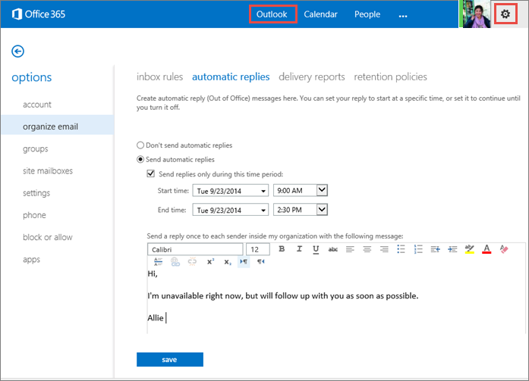
Set up automatic replies for email
To set up automatic replies in your browser window using Outlook Web App:
Sign into Office 365, then choose Outlook.
Choose Settings > Set automatic replies.
On the automatic replies page, select Send automatic replies.
Select the checkbox next to Send replies only during this time period, and then specify start and end dates and times.
In the box below font settings, type the message that you want people inside your organization to see when they send you email.
Scroll down the page.

Slide 15
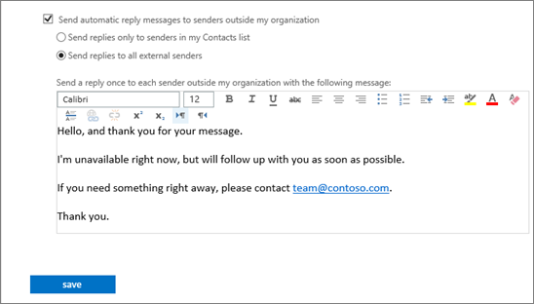
Set up automatic replies for email (cont’d)
If you want to send a message to people outside your organization, select the appropriate options.
Then type your message and select save.
When people send you email messages during the time for which automatic replies are set, they’ll get the reply you created.
To set up automatic replies in Outlook on your desktop, see Set up automatic replies.

Slide 16
Find or add a contact
When you first sign into Office 365, it might look like you have no contacts at all. You do have access to people in your organization even if you’re not sure where they are at first.
A good place to start is by finding people in your organization, then you can add them to your contacts list. You can also add external people as contacts.

Slide 17
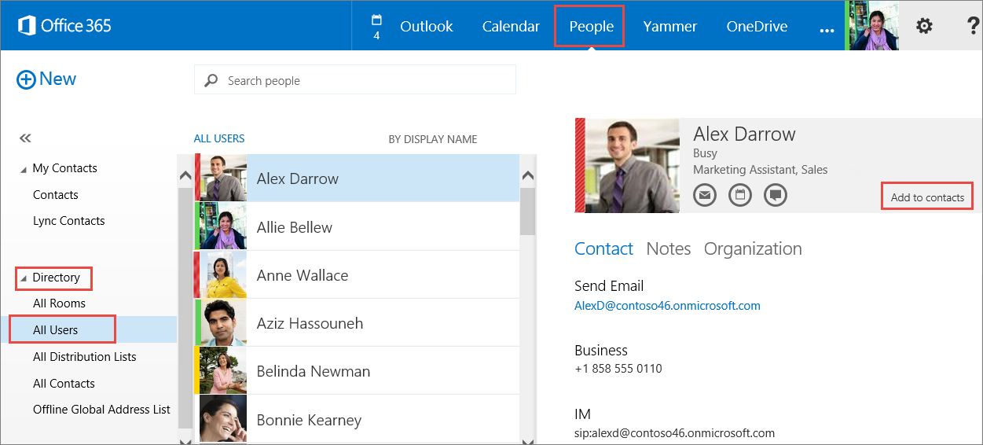
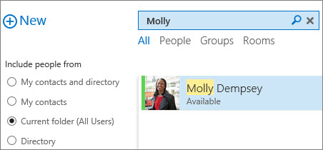
Find a contact
Sign into Office 365, then choose People.
In the left pane, under Directory, choose All Users to see the list of all people within your organization.
Search for someone by typing their name in the Search box. Make sure the All Users folder is selected.
To add someone from the list, choose their name and then select Add to Contacts.
To find a contact in Outlook on your desktop:
If you’re using Windows, see Add and use contacts.
If you’re using Mac, see: Find a contact.

Slide 18
Schedule a meeting
Use your calendar to stay organized by having your meetings and appointments in one place, available across all your devices. In just a few clicks (or taps), you can set up a meeting with someone or an appointment for yourself, and get reminders ahead of time so you don't miss anything.

Slide 19
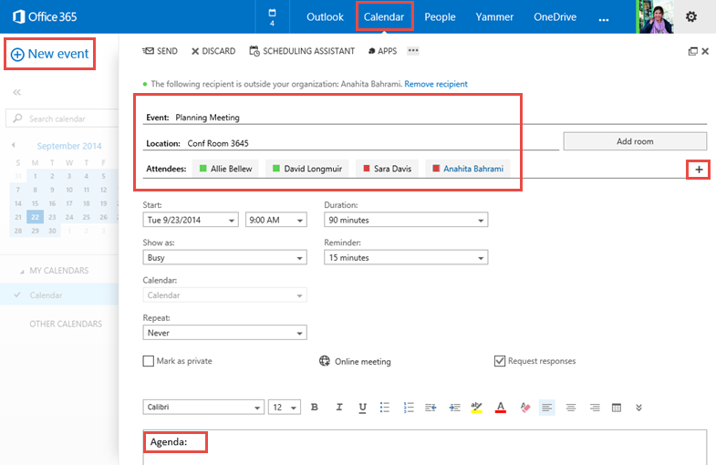
Schedule a meeting
To schedule a meeting in Outlook Web App:
Sign into Office 365, then choose Calendar.
Choose + New event.
Type the event (meeting) name and location.
For Attendees, type the names in the space available, or choose + (Plus Sign) to open your list of contacts, then add the invitees.
Select Scheduling Assistant at the top of the meeting invite to see your invitee’s availability before you set the date and time.
Specify the date, time, duration and reminder.
Type the agenda and select SEND.
To schedule a meeting in Outlook on your desktop:
If you’re using Windows, see Schedule a meeting with other people
If you’re using Mac OS, see: Create a meeting or appointment

Slide 20
Share your calendar with others
With Office 365 you can share your calendar with anyone inside or outside your organization. When you share your calendar with someone inside your organization, they will be able to add it directly to their calendar view in Outlook or Outlook Web App. People outside your organization will be sent a URL that they can use to view your calendar.
Note that Calendar sharing may not be available for your account, or may be limited to people in your organization.

Slide 21
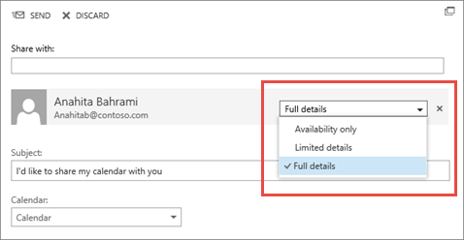
Share your calendar with others
Sign into Office 365, then choose Calendar > Share.
Type the name or email address of the person, or people that you want to share your calendar with in the Share with box.
Select how much information you want them to see, and then select SEND.
Full details will show the time, subject, location, and other details of all items in your calendar.
Limited details will show the time, subject, and location, but no other information.
Availability only will show only the time of items on your calendar.
To share your calendar in Outlook on your desktop:
If you’re using Windows, see Share an Outlook calendar with other people
If you’re using Mac OS, see: View and share calendars.

Slide 22
View a shared calendar
Others can share their calendar with you, and depending on the permission they give you, you’ll be able to view their calendar, edit it, or act as a delegate for meeting requests.

Slide 23
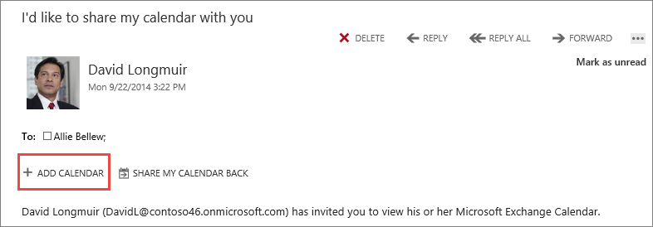
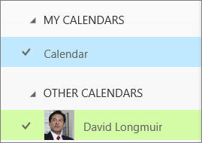
View a shared calendar
When someone shares their calendar with you, you receive a notification with information about your access.
Select +ADD CALENDAR, to accept the shared calendar.
Then go to your Calendar tab and select the shared calendar to view the items.
For more information about shared calendars in Outlook on your desktop:
If you’re using Windows, see Share an Outlook calendar with other people
If you’re using Mac OS, see: Open a shared calendar.

Slide 24
Search your email or calendar
There are multiple ways to search for your email messages, people or calendar items.

Slide 25
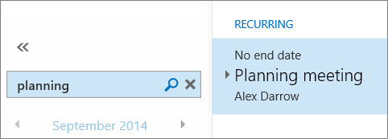
Search your email or calendar
You can search for messages and people in Outlook Web App by using the search box at the top of each window.
Sign into Office 365 and select Outlook.
Type what you want to search for in the Search mail and people box and press Enter.
Refine your search by selecting one of the filters below the search box: All, Unread, To me, or Flagged.
Select Calendar, and type what you want to search for in the Search Calendar box.
To search in Outlook on your desktop:
If you’re using Windows, see Search for Calendar items, and Search for messages.
If you’re using Mac OS, see: Find items in Outlook by doing a basic search.

Slide 26
Assign tasks for yourself or others
You can use tasks to set up a to-do list for yourself that's available on all your devices. And, if Outlook is installed on your computer, you can assign tasks to other people.

Slide 27
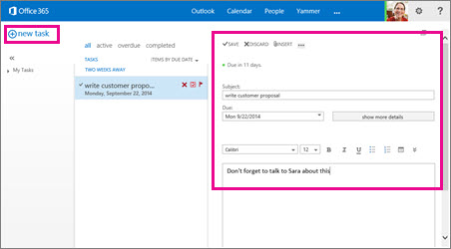
Set up a task for yourself
Sign into Office 365, then choose Calendar.
In the lower-left corner of the window, select TASKS.
In the top left corner of the window, select + New task.
Fill out details such as a subject, due date, and other information about your task.
Choose SAVE when you're done.
To manage your tasks in Outlook for Mac 2011, see: Stay focused with My Day.

Slide 28
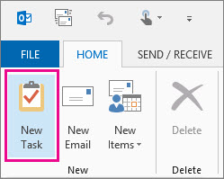
Assign a task to someone else
If you have Outlook installed on your computer, you can use it to assign tasks to others.
Open Outlook, and on the navigation bar at the bottom of the window, select Tasks.
Select New Task on the ribbon on top of the window.
Fill out details such as a subject, due date, and other information about your task.
On the ribbon, choose the Task tab, and then choose Assign Task.
Choose To, and then select the person to whom you want to assign the task.
Select Send.

Slide 29
Additional resources
Follow these roadmaps to learn more about using email and calendars on your desktop (Mac and Windows), or mobile devices using a step-by-step approach.
Outlook Web App options on a mobile device
Learning roadmap for Outlook for Mac 2011
Training courses for Outlook 2013 for windows
Working with your email, calendar, and contacts on your Android Phone
Working with your email, calendar, and contacts on your iPhone
Working with your email, calendar, and contacts on your iPad
Working with your email, calendar, and contacts on your Windows Phone

Slide 30
© 2014 Microsoft Corporation. All rights reserved. Microsoft, Windows, and other product names are or may be registered trademarks and/or trademarks in the U.S. and/or other countries.
The information herein is for informational purposes only and represents the current view of Microsoft Corporation as of the date of this presentation. Because Microsoft must respond to changing market conditions, it should not be interpreted to be a commitment on the part of Microsoft, and Microsoft cannot guarantee the accuracy of any information provided after the date of this presentation. MICROSOFT MAKES NO WARRANTIES, EXPRESS, IMPLIED OR STATUTORY, AS TO THE INFORMATION IN THIS PRESENTATION.

