Slide 1


Get it done from anywhere
Training Deck
Microsoft Corporation
Notes:
Welcome to Get it done from anywhere, the first path in the Office 365 Learning Center.
-------------------
1. Get it done from anywhere
2. Email and calendar on the go
3. Store, sync, and share your work files
4. Run more effective meetings
5. Work like a network
-------------------

Slide 2
Get it done from anywhere
Get it done from anywhere
Open Word, Excel, or PowerPoint and create a new document
Save, edit, and share Office documents from anywhere
View Office documents on a mobile device
OneNote from anywhere
Getting it done quickly with Office Online

Slide 3

Get it done from anywhere
With Office 365, you always have access to your documents so you can work from home, on the road, or in the office.
Installing Office on up to five devices gives you a consistent experience with your work files across your devices.
With Office 365, you will always have the latest versions of Word, Excel, PowerPoint, and OneNote.

Slide 4
What’s included in my Office installation?
Before you continue, install Office on your computer or mobile device (if you haven’t already). See Install Office using Office 365 for Business (http://go.microsoft.com/fwlink/?LinkID=511279) and Install apps on your mobile devices (http://go.microsoft.com/fwlink/?LinkID=511280) for installation steps.
Office includes the apps you may already know, such as Word, Excel, PowerPoint, and OneNote.

Slide 5
Open Word, Excel, or PowerPoint and create a new document
  Open a Word, Excel, or PowerPoint document and see how easy it is to start working with Office 365.

Slide 6
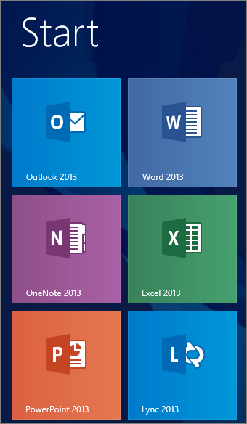
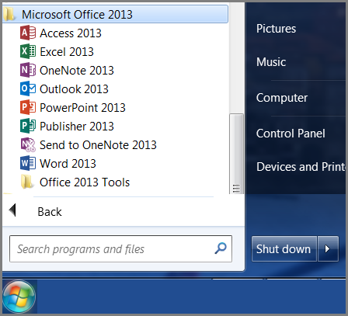
Find and open Word, Excel, or PowerPoint
Where you find your desktop apps depends on which computer you installed Office.
In Windows 8, select Start and scroll to see the apps page on the Start screen.
In Windows 7, select Start >Programs >Microsoft Office 2013.

Slide 7
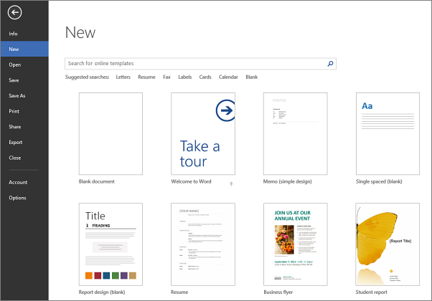
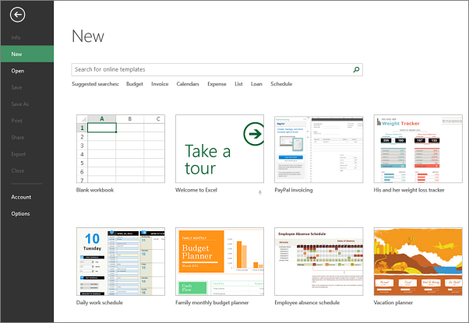
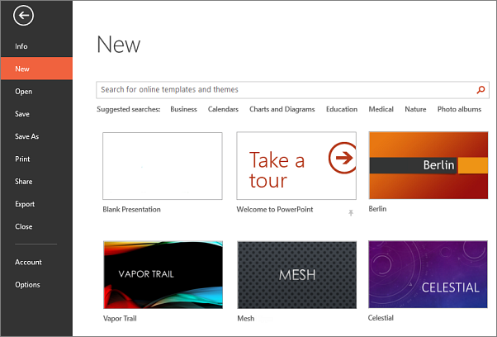
Create a new Word, Excel, or PowerPoint document
After you open Word, Excel, or PowerPoint, select a template, or a blank document, workbook, or presentation and begin adding your content.

Slide 8
Save, edit, and share Office documents from anywhere
In Office 365, save your work or school documents to OneDrive for Business so you can access them from different devices.

Slide 9
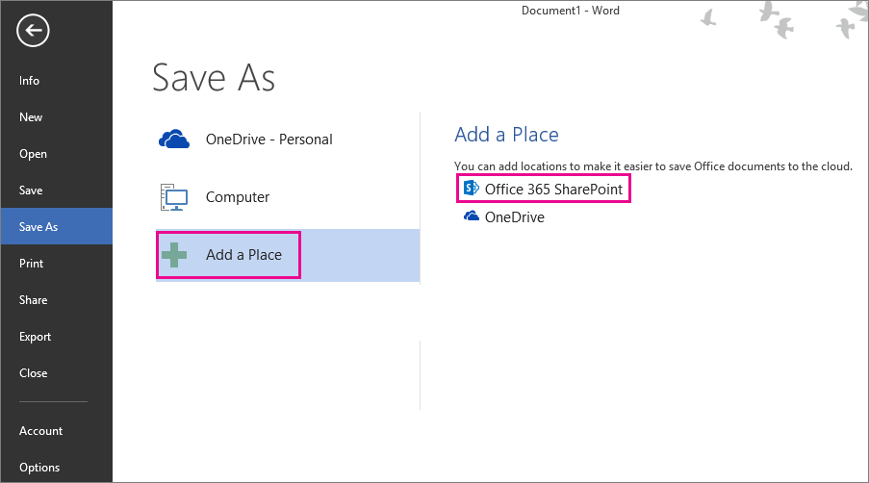
Saving your document
In the file you created, select File > Save (or Save As).
If this is your first time saving an Office document to OneDrive for Business, select Add a Place > Office 365 SharePoint.
Sign in with your organizational account. For example, ellen@contoso.onmicrosoft.com, ellen@contoso.edu, or ellen@contoso.com. If you're not sure what your organizational account is, check the welcome email message that asked you to sign in the first time.
Choose where you want to save your file and select Save.

Slide 10
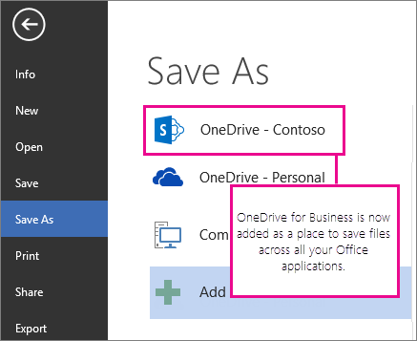
Saving to OneDrive for Business every time
Once you add OneDrive for Business as a place in one Office app, you can save files from all your Office apps.
The next time you save a document, it appears in your Save As list as OneDrive - <Company Name>.
If you have a Microsoft account such as outlook.com or hotmail.com, you’ll see two OneDrive locations:
Use OneDrive - <Company Name> for work or school documents
Use OneDrive - Personal for your personal documents

Slide 11
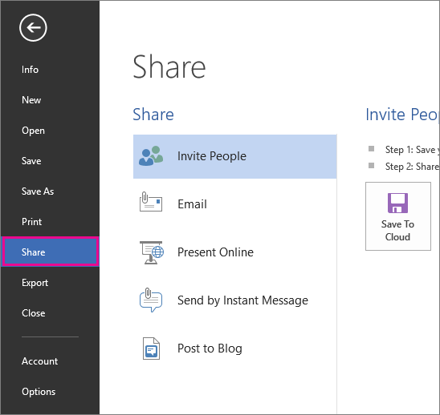
Sharing Office documents
In the app you’re working in, select File, then select Share.
From the Share list, select how you want to share the file, and then the people you want to share with.

Slide 12
View Office documents on a mobile device
When save your files to OneDrive for Business, you can access them from your mobile device. Set up Office Mobile on your Windows Phone, iPhone, or Android Phone. For iPad, install and set up the Word, Excel, PowerPoint, and OneNote apps on your iPad.
  If you haven’t installed Office Mobile or Office for iPad see, Working with Office documents in a browser or mobile app (http://go.microsoft.com/fwlink/?LinkID=510963).

Slide 13
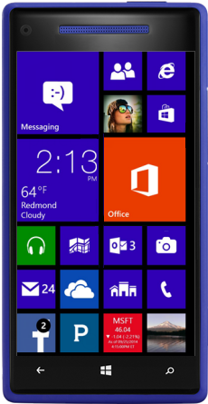
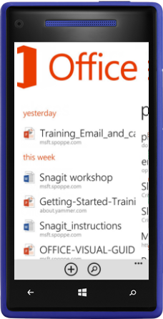
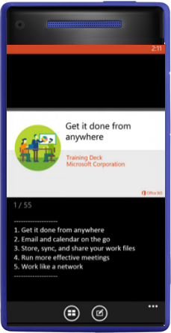
Get to your documents from a mobile device
  Once you save documents to OneDrive for Business and you set up Office Mobile on your device, you can get to your docs with a few taps.
  Here’s an example of how to get to your documents on a Windows Phone.
  On your Windows Phone, tap the Office app.
  Office Mobile will show your most recent documents. Tap the document you want to open or swipe left for Places, tap OneDrive @ <your domain name>, and then tap the document you want.
  Your Office document is opened so you can view or edit it.
1
2
3
Tap the Office icon
Tap to open a recent doc
An Office document is opened

Slide 14
OneNote from anywhere
Use OneNote to stay organized and collaborate with your team on all your devices. Your notes save automatically and when you store your notebooks online in OneDrive for Business, you can update and share them from other devices.
  Get to your notes from anywhere using a browser or in the OneNote mobile app on your device. If you don’t have OneNote installed on your mobile device, see Working with Office documents in a browser or mobile app (http://go.microsoft.com/fwlink/?LinkID=510963.)

Slide 15
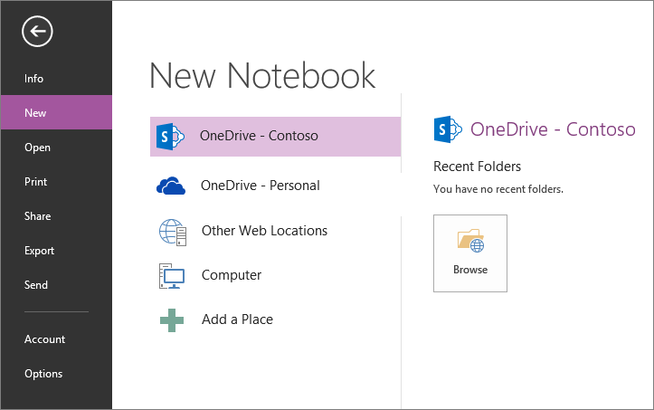
Create a new OneNote notebook
  When you first open OneNote, it creates a sample notebook for you. Use this notebook to get started or create your own.
  Select File > New.
  Select one of the available locations (for example, OneDrive – <Company Name>), or select Add a Place to tell OneNote where you want to store the new notebook.

Slide 16
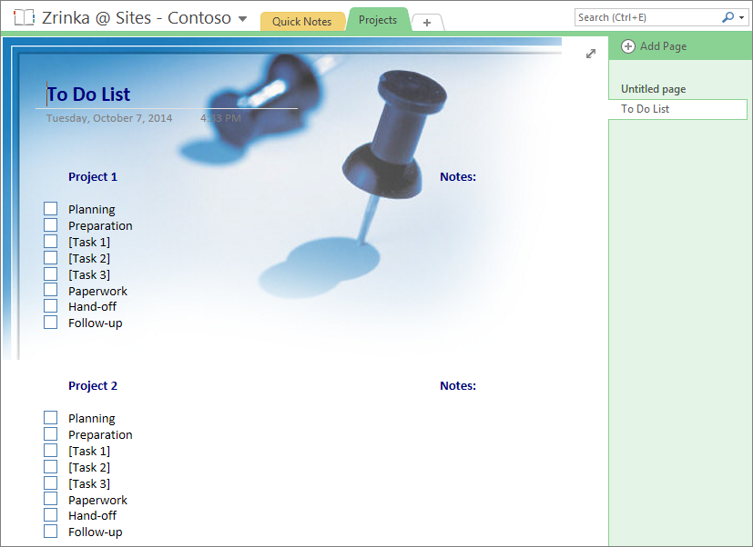
Use OneNote templates
  OneNote includes templates that can save you time by adding functional content to pages, such as to-do lists, calendars, planners, and forms that you can fill out or customize. Browse through the built-in collection of templates to add a pre-formatted page to your notebook.
  On the ribbon, select Insert > Page Templates.
  In the Templates task pane, expand the categories, and then select a template to view it.
  Use OneNote page templates to save time

Slide 17
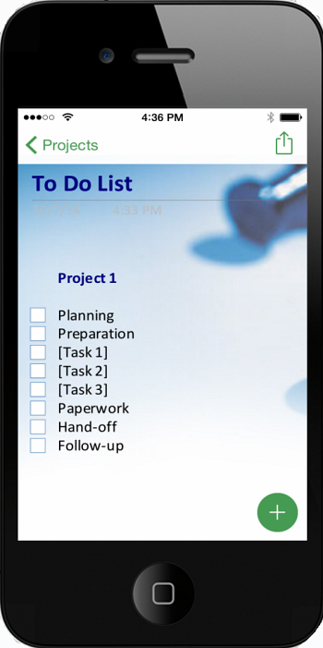
Get your OneNote notebooks on the go
  OneNote doesn’t have a Save button, because your changes save automatically.
  So, the changes you make on work computer are available for you to review on your mobile device. And no need to save.
  Open the OneNote app on your mobile device.
  You may need to sync or refresh the app to view the latest version.
  The same OneNote page you created on your computer is available on your mobile device.

Slide 18
Get it done quickly with Office Online
When you’re using a computer that doesn’t have the full desktop version of Office installed, Office Online is your Office in the cloud. View your documents, and even PDFs, in your browser or make quick changes in the online versions of Word, Excel, PowerPoint, OneNote.

Slide 19
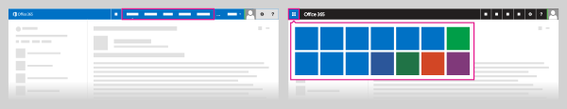
Office on the go with Office Online
When Word, Excel, PowerPoint and OneNote documents are stored in OneDrive for Business or other Office 365 libraries, you can work on them using Office Online, which opens the documents in a web browser.
Sign in to Office 365 at http://portal.office.com. For example, ellen@contoso.onmicrosoft.com, ellen@contoso.edu, or ellen@contoso.com. If you're not sure what your organizational account is, check the welcome email message that asked you to sign in the first time.​
At the top of the site, select OneDrive, or and then select OneDrive.

Slide 20
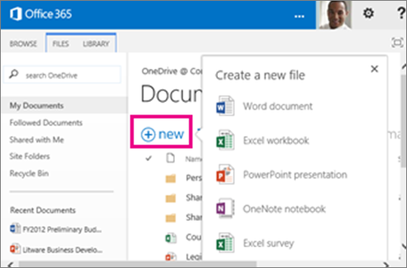
Create and save files using Office Online
After signing in to Office 365, you can begin using the Office Online applications such as Word Online or Excel Online.
At the top of the page, select OneDrive or select and then select OneDrive.
Select New Document, and then choose the type of document you want to create.
When you create, open, or edit a document in OneDrive for Business, it's automatically saved to the same location. You can now access this file from any device.

Slide 21

© 2014 Microsoft Corporation. All rights reserved. Microsoft, Windows, and other product names are or may be registered trademarks and/or trademarks in the U.S. and/or other countries.
The information herein is for informational purposes only and represents the current view of Microsoft Corporation as of the date of this presentation. Because Microsoft must respond to changing market conditions, it should not be interpreted to be a commitment on the
part of Microsoft, and Microsoft cannot guarantee the accuracy of any information provided after the date of this presentation. MICROSOFT MAKES NO WARRANTIES, EXPRESS, IMPLIED OR STATUTORY, AS TO THE INFORMATION IN THIS PRESENTATION.

