Slide 1
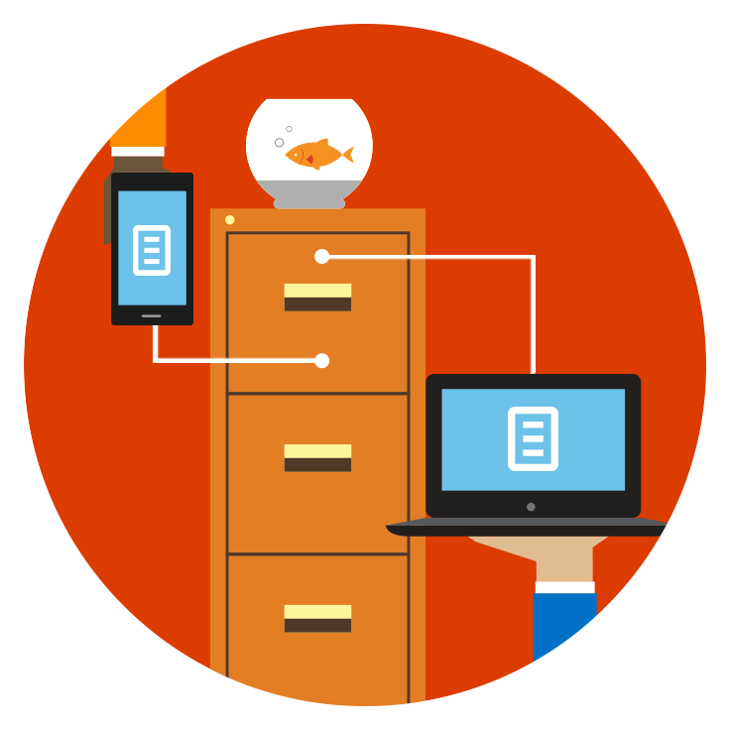

Store, sync, and share your work files
Training Deck
Microsoft Corporation
Notes:
Welcome to the Learning Path: Store, sync, and share your work files, part of the following series of Learning Paths:
-------------------
1. Get it done from anywhere
2. Email and calendar on the go
3. Store, sync, and share your work files
4. Run more effective meetings
5. Work like a network
-------------------

Slide 2
Store, sync, and share your work files
Drag and drop files to OneDrive for Business
See your files from other devices
Save and open files
Sync your files with your computer
Manage your files in OneDrive for Business
Share files with others
Work together at the same time

Slide 3
Drag and drop files to OneDrive for Business
OneDrive for Business is the place where you can store, share, and sync your work files and then get to them from anywhere on virtually any device. The first step is to drag some files to OneDrive for Business in a browser.
In this module, you’ll learn how to:
Drag files to OneDrive for Business
Upload files to OneDrive for Business

Slide 4
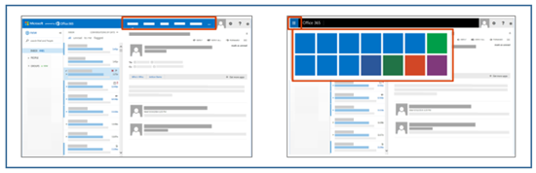
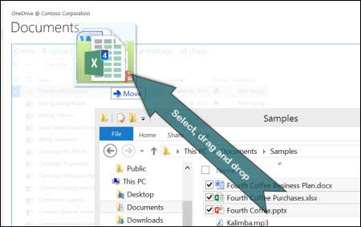
Drag and drop files to OneDrive for Business
  At the top of any page in Office 365, select OneDrive. Or select , and then select OneDrive.
  Find the documents that you want to upload on your computer and drag them to the space in the library where it says drag files here.
  Note: The first time you click OneDrive, you see some setup screens and instructions while your personal site is being set up. You may have to wait and then click OneDrive again before continuing to step 2.
  If you don’t see the option to drag and drop files, update your copy of Office.

Slide 5
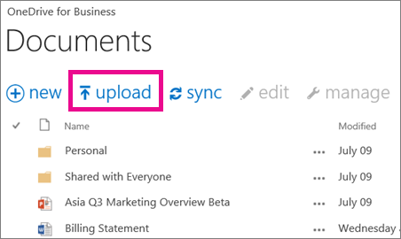
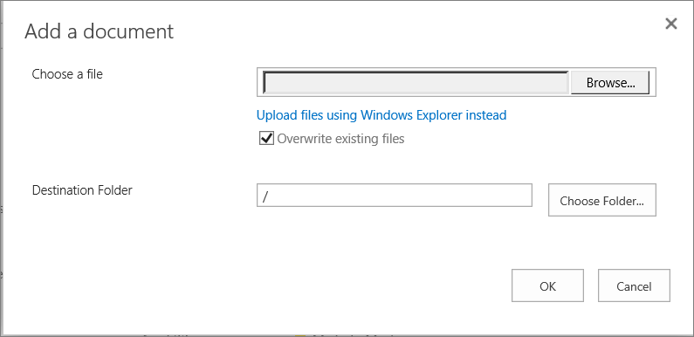
Upload files to OneDrive for Business
Here’s another way to do it:
Instead of dragging files, select Upload.
In the Choose File to Upload dialog box, select the files you want to upload, and then click Open.
Tip: Your files are private unless you decide to share them. To share files easily with everyone in your organization, drag them into your Shared with Everyone folder. For more about sharing, see Sharing files with others.

Slide 6
See your files from other devices
After you upload files to OneDrive for Business, you can see them from other devices by just signing into your Office 365 site in your browser, and then clicking OneDrive.
In this module, you’ll learn how to:
See your files from other devices

Slide 7
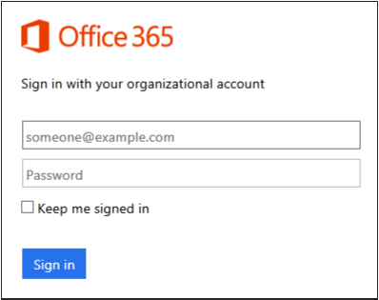
See your files from other devices
  The files you upload from any device are right there for you to use.
  On any device, sign in to Office 365 with your organizational account.
  For example, ellen@contoso.onmicrosoft.com, ellen@contoso.edu, or ellen@contoso.com.
  If you're not sure what your organizational account is, check the welcome email that asked you to sign in the first time.
  At the top of any page in Office 365, select OneDrive. Or select , and then select OneDrive.

Slide 8

Get the OneDrive for Business app
  For a better experience, get the OneDrive for Business app for your device at OneDrive.com:
  https://onedrive.live.com/about/en-us/download/

Slide 9
Save and open files
You can work with the files you store in OneDrive for Business right from Word, Excel, PowerPoint, and other Office desktop apps. There's no need to go to your Office 365 site in a browser.
In this module, you’ll learn how to:
Save a file
Open a file
Add a place to save a file

Slide 10
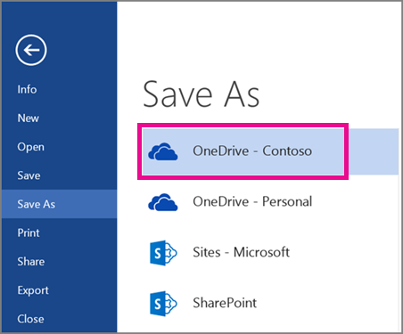
Save and open files: Save a file
  Save a file to OneDrive for Business from an Office desktop app:
  Open a document in an Office desktop app such as Word, Excel, or PowerPoint, and then click File > Save As > OneDrive - YourCompanyName.
  For example, OneDrive - Contoso.
  Browse to the file you want to open, and then click Open.

Slide 11
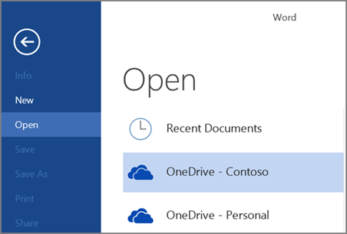
Save and open files: Open a file
  Open a OneDrive for Business file from an Office desktop app:
  In an Office desktop app such as Word, Excel, or PowerPoint, click File > Open > OneDrive - YourCompanyName.
  For example, OneDrive – Contoso.
  Browse to the file you want to open, and then click Open.

Slide 12
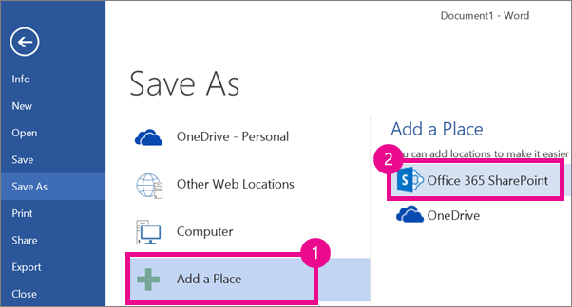
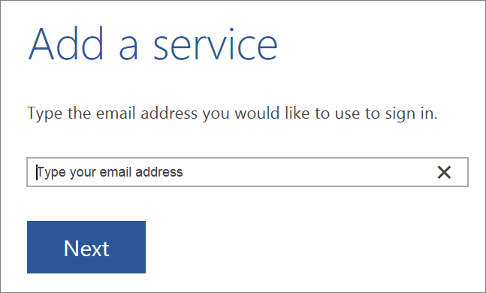
Save and open files: Add a place
If you don't see OneDrive – YourCompanyName on the Save As or Open:
Select Add a Place > Office 365 SharePoint.
Sign in to Office 365 with your organizational account.
Once you add OneDrive for Business as a place in one Office app, you can save files from all your Office apps.

Slide 13
Create and save from a site or mobile app
For information about creating and saving files directly on an Office 365 site or from a mobile app, see Working with Office documents in a browser or mobile app.

Slide 14
Sync your files with your computer
Sync OneDrive for Business to your computer, and then get to your files in File Explorer instead of in a web browser. All your changes sync to OneDrive for Business whenever you’re online.
In this module, you’ll learn how to:
Sign in to your site
Sync your files

Slide 15
Sync your files: Sign in to your site
On any device, sign in to Office 365 with your organizational account.
For example, ellen@contoso.onmicrosoft.com, ellen@contoso.edu, or ellen@contoso.com.
If you're not sure what your organizational account is, check the welcome email that asked you to sign in the first time.
  At the top of any page in Office 365, select OneDrive. Or select , and then select OneDrive.

Slide 16
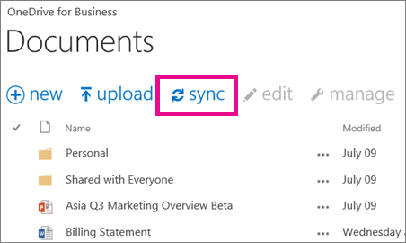
Sync your files: Sync your files
On your OneDrive for Business page, click Sync.
At the prompt, click Sync Now to start the sync app.
The app automatically fills out the name and web address of your OneDrive for Business library.

Slide 17
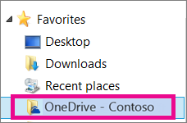
Sync your files: Sync your files, continued
  Select Sync Now in the app to start syncing.
  You can click Show my files in the app to open the synced OneDrive for Business folder in File Explorer. The folder appears in your Windows Favorites as OneDrive for Business or OneDrive - YourCompanyName.
  Note: To sync files to your computer, you need the OneDrive for Business sync app, available with an Office 365 subscription that includes Office 2013 desktop applications. If you don’t have Office 2013, you can download the OneDrive for Business sync app.
  For more information about syncing, including troubleshooting information, see Sync OneDrive for Business or site libraries to your computer.

Slide 18
Manage your files in OneDrive for Business
After you sync your OneDrive for Business files with your computer, you can manage your files like other files on your computer. You move, rename, and delete your files the same way you're used to, except the changes you make to OneDrive for Business files sync to all your other devices. So if you delete a file here, it's deleted everywhere.
In this module, you’ll learn how to:
Copy or move a file
Rename a file
Delete a file

Slide 19
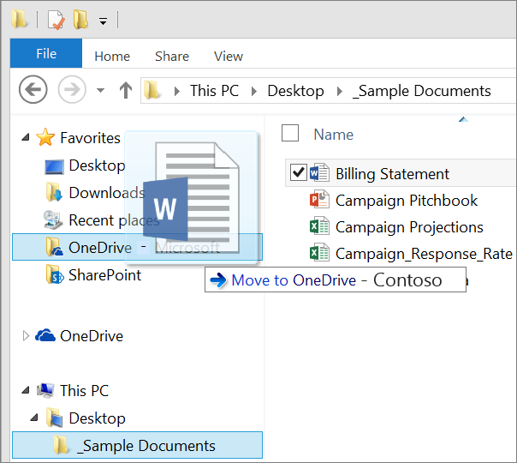
Manage your files: Copy or move files
In File Explorer, select the files you want to copy or move.
Right-click the files and drag them to your OneDrive - YourCompanyName folder or to another location.

Slide 20
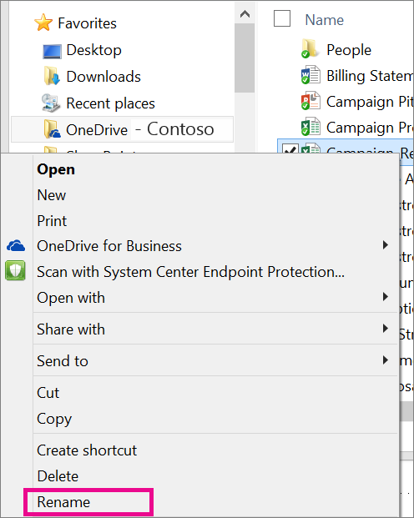
Manage your files: Rename a file
Right-click the file you want to rename in your OneDrive - YourCompanyName folder.
Select Rename on the shortcut menu.
Type the new name for your file.

Slide 21
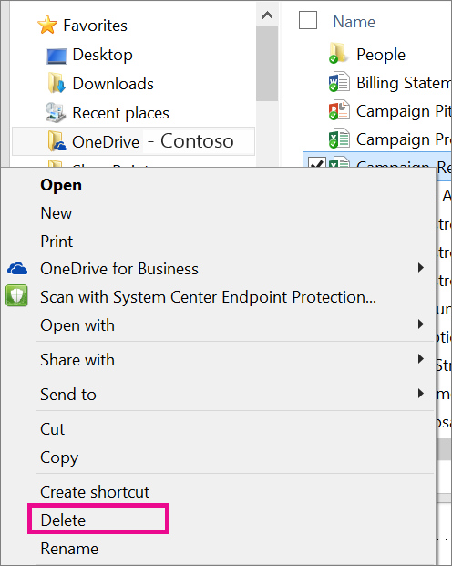
Manage your files: Delete a file
  Select the file you want to delete in your OneDrive - YourCompanyName folder.
  Press Delete on your keyboard.
  Tip: Remember, any changes you make to a file in your OneDrive for Business folder apply to all devices, not just to this computer. The changes will sync to all your other devices.

Slide 22
Share files with others
When you store your files in OneDrive for Business, you can share with others from any device by going to your Office 365 site. Or you can share right from Office without even going to Office 365 in a separate window. Whichever way you share Office files, you can work with others at the same time they work and see changes as people make them.
In this module, you’ll learn how to:
Share a file with everyone from a site
Share a file with individuals from a site
Share a file from an Office desktop

Slide 23
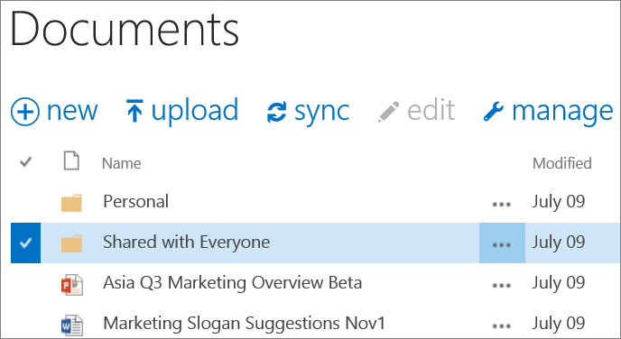
Share a file with everyone from a site
  At the top of any page in Office 365, select OneDrive. Or select , and then select OneDrive.
  Drag the files into your Shared with Everyone folder.
  Or if you already have the Share window open (as in step 2 above), type Everyone instead of the name of a person.

Slide 24
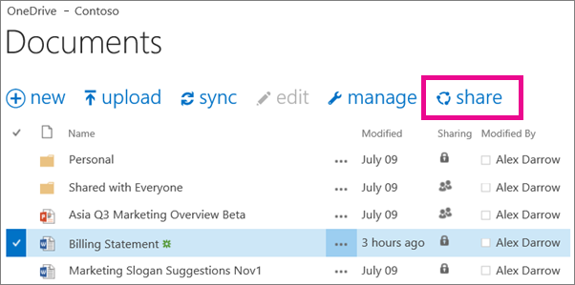
Share a file with individuals from a site
  At the top of any page in Office 365, select OneDrive. Or select , and then select OneDrive.
  Select the file you want to share, and then select Share.

Slide 25
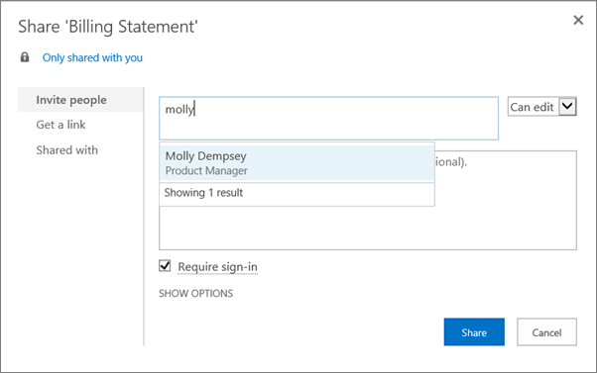
Share a file with individuals from a site
  In the Share window, type the name of each person you want to share the file with. As you type each name, suggestions appear that match your contacts. When you see the name you want, select it to add it to the invitation list.
  Select the permission in the list that you want to grant people. You can change the permission later for any person.
  If you want, type a message to send to all the people you're inviting. The email message invitees receive will include a link to the shared document.
  If you don't want to send an email to invitees, click Show Options, and then clear Send an email invitation.
  Click Share.

Slide 26
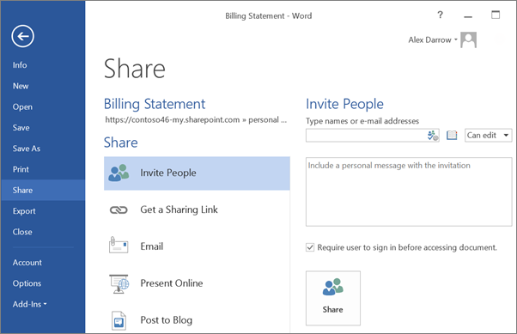
Share a file from an Office desktop app
  With the file open in Word, Excel, PowerPoint, or another Office app, click File > Share > Invite People.
  Under Invite People, type the name of each person you want to share the file with. As you type each name, suggestions appear that match your contacts. When you see the name you want, select it to add it to the invitation list.
  If you want, type a message to send to all the people you're inviting. The email message invitees receive will include a link to the shared document.
  If you don't want to send an email to invitees, click Show Options, and then clear Send an email invitation.
  Click Share.

Slide 27
Work together at the same time
When you store and share your files in OneDrive for Business, you can work with others at the same and avoid reconciling multiple versions of your files. Work together from either the online or the desktop versions of Word, PowerPoint, or OneNote. For workbooks, use Excel Online. If someone opens the workbook in the Excel desktop application, the workbook can’t be edited in Excel Online until it’s closed again in desktop Excel.
In this module, you’ll learn how to:
Work with others at the same time

Slide 28

Work together at the same time
  Here are a few details to keep in mind as you work with others:
  In the desktop programs, co-authoring works best in the most recent version of Office (Mac and Windows), but is also supported in Office 2010.
  There's no special co-authoring mode and no command to begin working together on a document. Just open the file for editing and start working.
  As you edit, the Office app tells you when other people are working too. In Word, you'll even see which paragraph they’re working on.
  Updates are handled differently in some programs from others. For example, OneNote notebooks and Excel Online workbooks show updates immediately. In Word documents, save the document to share your updates and to see others’ updates.

Slide 29
Additional resources
For more information about OneDrive for Business, see the following resources:
Store and Share Documents Quick Start Guide
Sync OneDrive for Business or site libraries to your computer
  Get the OneDrive for Business mobile app for your device
Find more Learning Paths at the Office 365 Learning Center

Slide 30

© 2014 Microsoft Corporation. All rights reserved. Microsoft, Windows, and other product names are or may be registered trademarks and/or trademarks in the U.S. and/or other countries.
The information herein is for informational purposes only and represents the current view of Microsoft Corporation as of the date of this presentation. Because Microsoft must respond to changing market conditions, it should not be interpreted to be a commitment on the
part of Microsoft, and Microsoft cannot guarantee the accuracy of any information provided after the date of this presentation. MICROSOFT MAKES NO WARRANTIES, EXPRESS, IMPLIED OR STATUTORY, AS TO THE INFORMATION IN THIS PRESENTATION.

