Slide 1
Publishing and distribution: qr codes

Slide 2
Smart phone QR reader apps
Please download one of the many QR reader apps so you may scan the included codes:
Apple App Store
Google Play Store
QR Code Reader by Scan (Preferred)
Quick Scan
QR & Barcode Scanner
Google Goggles
Powerful QR Scanner

Slide 3
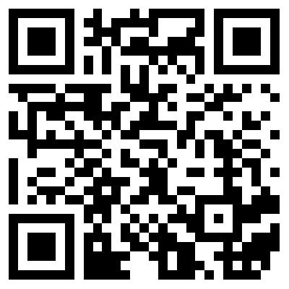
QR Codes and You!
QR codes make the real world clickable just like digital content. Point and click with your phone in reality to link to digital media.

Slide 4
Types of QR Codes
URL – Link to any website
Plain text
Contact card – Add as a contact
SMS – Autofill number and message
Call – Autofill number
Geolocation
Event – Auto add calendar appointment
Email – Autofill recipient and message
Wi-Fi – Auto connect to secure network
4

Slide 5
Office Plaque

Slide 6
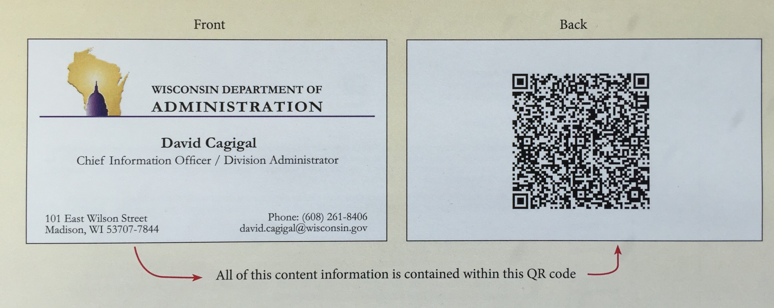
Business Cards
You can scan and have vital information without having to type anything

Slide 7
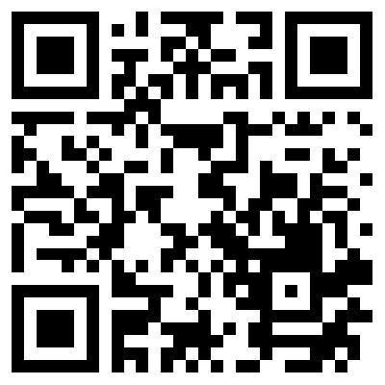
Static Barcode with Variable Output
Using QR codes to link to videos, webpages and other digital content allows for always-up-to-date information.
A code that links to a webpage will always show the newest version of that page.
Update phone lists, security procedures, etc. and when the code is scanned all updated information is available.
If you would like to know more:

